Slide 1
Switching
A network is a set of connected devices. Whenever multiple devices are used, there is problem that how to connect them to make one-to-one communication possible.
A better solution is switching.
A switched network consists of a series of interlinked nodes, called switches. Switches are devices capable of creating temporary connections between two or more devices linked to the switch.
In a switched network, some of these nodes are connected to the end systems (computers or telephones, for example). Others are used only for routing.
Figure shows a switched network.

Slide 2
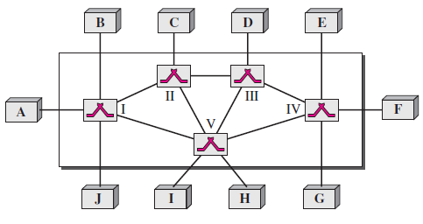
The end systems (communicating devices) are labeled A, B, C, D, and so on, and the switches are labeled I, II, III, IV, and V. Each switch is connected to multiple links.

Slide 3
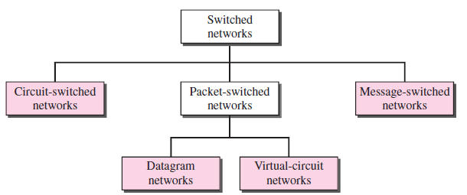
Switching
Switching is divided into three broad categories: circuit-switched networks, packet-switched networks, and message-switched.
Packet-switched networks can further be divided into two subcategories—virtual-circuit networks and datagram networks

Slide 4
CIRCUIT-SWITCHED NETWORKS
A circuit-switched network consists of a set of switches connected by physical links.
A connection between two stations is a dedicated path made of one or more links.
However, each connection uses only one dedicated channel on each link.
Each link is normally divided into n channels by using FDM or TDM.

Slide 5
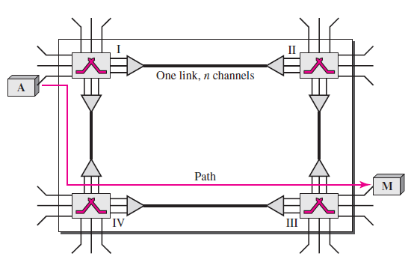
CIRCUIT-SWITCHED NETWORKS
Figure shows a trivial circuit-switched network with four switches and four links.
Each link is divided into n (n is 3 in the figure) channels by using FDM or TDM.

Slide 6
CIRCUIT-SWITCHED NETWORKS
The end systems, such as computers or telephones, are directly connected to a switch.
It have shown only two end systems for simplicity.
When end system A needs to communicate with end system M, system A needs to request a connection to M that must be accepted by all switches as well as by M itself.
This is called the setup phase; a circuit (channel) is reserved on each link, and the combination of circuits or channels defines the dedicated path.
After the dedicated path made of connected circuits (channels) is established, data transfer can take place.
After all data have been transferred, the circuits are torn down.

Slide 7
CIRCUIT-SWITCHED NETWORKS
Circuit switching takes place at the physical layer.
Before starting communication, the stations must make a reservation for the resources to be used during the communication. These resources, such as channels (bandwidth in FDM and time slots in TDM), switch buffers, switch processing time, and switch input/output ports, must remain dedicated during the entire duration of data transfer until the teardown phase.
Data transferred between the two stations are not packetized (physical layer transfer of the signal). The data are a continuous flow sent by the source station and received by the destination station, although there may be periods of silence.
There is no addressing involved during data transfer. The switches route the data based on their occupied band (FDM) or time slot (TDM). Of course, there is end-to end addressing used during the setup phase.

Slide 8
CIRCUIT-SWITCHED NETWORKS: Setup Phase
Before the two parties (or multiple parties in a conference call) can communicate, a dedicated circuit (combination of channels in links) needs to be established.
The end systems are normally connected through dedicated lines to the switches, so connection setup means creating dedicated channels between the switches.
For example, in Figure, when system A needs to connect to system M, it sends a setup request that includes the address of system M, to switch I. Switch I finds a channel between itself and switch IV that can be dedicated for this purpose.
Switch I then sends the request to switch IV, which finds a dedicated channel between itself and switch III.
Switch III informs system M of system A’s intention at this time.

Slide 9
CIRCUIT-SWITCHED NETWORKS: Setup Phase
In the next step to making a connection, an acknowledgment from system M needs to be sent in the opposite direction to system A.
Only after system A receives this acknowledgment is the connection established.
The end-to-end addressing is required for creating a connection between the two end systems.
These can be, for example, the addresses of the computers assigned by the administrator in a TDM network, or telephone numbers in an FDM network.

Slide 10
CIRCUIT-SWITCHED NETWORKS
Data Transfer Phase
After the establishment of the dedicated circuit (channels), the two parties can transfer data.
Teardown Phase
When one of the parties needs to disconnect, a signal is sent to each switch to release the resources.

Slide 11
CIRCUIT-SWITCHED NETWORKS: Efficiency
It can be argued that circuit-switched networks are not as efficient as the other two types of networks because resources are allocated during the entire duration of the connection.
These resources are unavailable to other connections.
In this case, allowing resources to be dedicated means that other connections are deprived.

Slide 12
CIRCUIT-SWITCHED NETWORKS: Delay
Although a circuit-switched network normally has low efficiency, the delay in this type of network is minimal.
During data transfer the data are not delayed at each switch; the resources are allocated for the duration of the connection.
The total delay is due to the time needed to create the connection, transfer data, and disconnect the circuit.
The delay caused by the setup is the sum of four parts: the propagation time of the source computer request, the request signal transfer time, the propagation time of the acknowledgment from the destination computer, and the signal transfer time of the acknowledgment.

Slide 13
CIRCUIT-SWITCHED NETWORKS: Delay
Although a circuit-switched network normally has low efficiency, the delay in this type of network is minimal.
During data transfer the data are not delayed at each switch; the resources are allocated for the duration of the connection.
The total delay is due to the time needed to create the connection, transfer data, and disconnect the circuit.
The delay caused by the setup is the sum of four parts: the propagation time of the source computer request (slope of the first gray box), the request signal transfer time (height of the first gray box), the propagation time of the acknowledgment from the destination computer (slope of the second gray box), and the signal transfer time of the acknowledgment (height of the second gray box).
The delay due to data transfer is the sum of two parts: the propagation time (slope of the colored box) and data transfer time (height of the colored box), which can be very long.
The third box shows the time needed to tear down the circuit.
We have shown the case in which the receiver requests disconnection, which creates the maximum delay.

Slide 14
Packet Switched: DATAGRAM NETWORKS
In data communications, The need to send messages from one end system to another.
If the message is going to pass through a packet-switched network, it needs to be divided into packets of fixed or variable size.
The size of the packet is determined by the network and the governing protocol.
In packet switching, there is no resource allocation for a packet.
This means that there is no reserved bandwidth on the links, and there is no scheduled processing time for each packet.

Slide 15
Packet Switched: DATAGRAM NETWORKS
Resources are allocated on demand.
The allocation is done on a first come, first-served basis.
When a switch receives a packet, no matter what is the source or destination, the packet must wait if there are other packets being processed.
As with other systems in our daily life, this lack of reservation may create delay.
For example, if we do not have a reservation at a restaurant, we might have to wait.

Slide 16
Packet Switched: DATAGRAM NETWORKS
In a datagram network, each packet is treated independently of all others.
Even if a packet is part of a multipacket transmission, the network treats it as though it existed alone.
Packets in this approach are referred to as datagrams.
Datagram switching is normally done at the network layer.

Slide 17
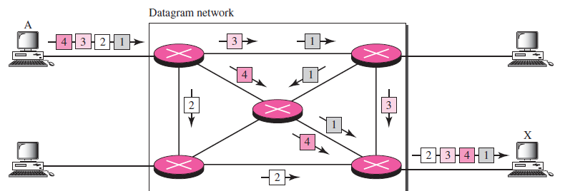
Figure shows how the datagram approach is used to deliver four packets from station A to station X.
The switches in a datagram network are traditionally referred to
as routers.
That is why different symbol is used for the switches in the figure.

Slide 18
Packet Switched: DATAGRAM NETWORKS
In the above example, all four packets of same message may travel different path to reach destination.
Because links may carrying packets of other necessary resources, have no enough bandwidth to carry all packets from A to X.
All packets are arrive at destination out of order with different delays.
If there is any loss or drop of packet and reordering of packets, it is handled by upper layer protocol.

Slide 19
Packet Switched: DATAGRAM NETWORKS
The datagram networks are sometimes referred to as connectionless networks.
The term connectionless here means that the switch (packet switch) does not keep information about the connection state.
There are no setup or teardown phases.
Each packet is treated the same by a switch regardless of its source or destination.

Slide 20
DATAGRAM NETWORKS: Routing Table
In this type of network, each switch (or packet switch) has a routing table which is based on the destination address.
The routing tables are dynamic and are updated periodically.
The destination addresses and the corresponding forwarding output ports are recorded in the tables.

Slide 21
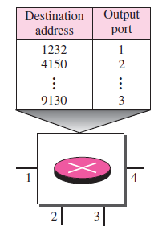

Slide 22
DATAGRAM NETWORKS: Destination Address
Every packet in a datagram network carries a header that contains, among other information, the destination address of the packet.
When the switch receives the packet, this destination address is examined; the routing table is consulted to find the corresponding port through which the packet should be forwarded.

Slide 23
DATAGRAM NETWORKS: Efficiency
The efficiency of a datagram network is better than that of a circuit-switched network; resources are allocated only when there are packets to be transferred.
If a source sends a packet and there is a delay of a few minutes before another packet can be sent, the resources can be reallocated during these minutes for other packets from other sources.

Slide 24
DATAGRAM NETWORKS: Delay
There may be greater delay in a datagram network than in a virtual-circuit network.
Although there are no setup and teardown phases, each packet may experience a wait at a switch before it is forwarded.
In addition, since not all packets in a message necessarily travel through the same switches, the delay is not uniform for the packets of a message.

Slide 25
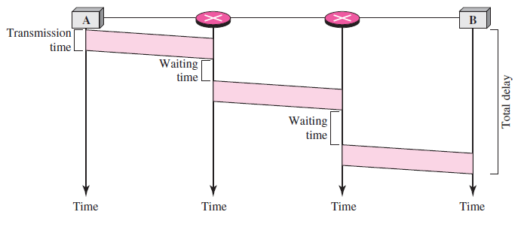
The packet travels through two switches. There are three transmission times (3T), three propagation delays (slopes 3τ of the lines), and two waiting times (w1 + w2). The processing time in each switch is ignored. The total delay is
Total delay = 3T + 3τ + w1 + w2

Slide 26
DATAGRAM NETWORKS
The Internet has chosen the datagram approach to switching at the network layer.
It uses the universal addresses defined in the network layer to route packets from the source to the destination.

Slide 27
VIRTUAL-CIRCUIT NETWORKS
A virtual-circuit network is a cross between a circuit-switched network and a datagram network. It has some characteristics of both:
As in a circuit-switched network, there are setup and teardown phases in addition to the data transfer phase.
Resources can be allocated during the setup phase, as in a circuit-switched network, or on demand, as in a datagram network.
As in a datagram network, data are packetized and each packet carries an address in the header.
As in a circuit-switched network, all packets follow the same path established during the connection.
A virtual-circuit network is normally implemented in the data link layer, while a circuit-switched network is implemented in the physical layer and a datagram network in the network layer.

Slide 28
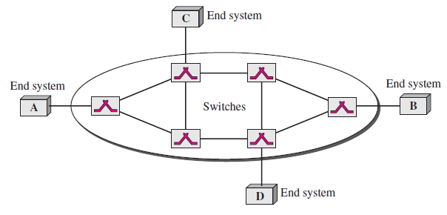
The network has switches that allow traffic from sources to destinations.
A source or destination can be a computer, packet switch, bridge, or any other device that connects other networks.

Slide 29
VIRTUAL-CIRCUIT NETWORKS: Addressing
Global Addressing
A source or a destination needs to have a global address—an address that can be unique in the scope of the network or internationally if the network is part of an international network.
However, The global address in virtual-circuit networks is used only to create a virtual-circuit identifier.
Virtual-Circuit Identifier
The identifier that is actually used for data transfer is called the virtual-circuit identifier VCI).
A VCI, unlike a global address, is a small number that has only switch scope; it is used by a frame between two switches.
When a frame arrives at a switch, it has a VCI; when it leaves, it has a different VCI.
Figure in next slide shows how the VCI in a data frame changes from one switch to another.
A VCI does not need to be a large number since each switch can use its own unique set of VCIs.

Slide 30
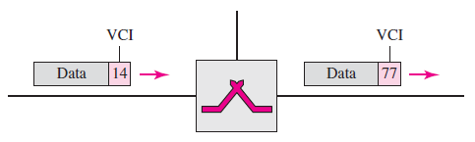

Slide 31
VIRTUAL-CIRCUIT NETWORKS
In the setup phase, the source and destination use their global addresses to help switches make table entries for the connection.
In the teardown phase, the source and destination inform the switches to delete the corresponding entry.
Data transfer occurs between these two phases.

Slide 32
VIRTUAL-CIRCUIT NETWORKS: Data Transfer Phase
To transfer a frame from a source to its destination, all switches need to have a table entry for this virtual circuit.
The table, in its simplest form, has four columns.
This means that the switch holds four pieces of information for each virtual circuit that is already set up.
Figure in next slide shows a frame arriving at port 1 with a VCI of 14. When the frame arrives, the switch looks in its table to find port 1 and a VCI of 14. When it is found, the switch knows to change the VCI to 22 and send out the frame from port 3.

Slide 33
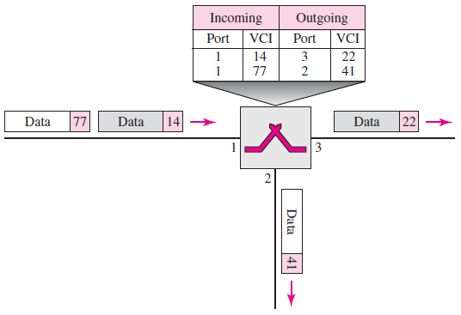

Slide 34
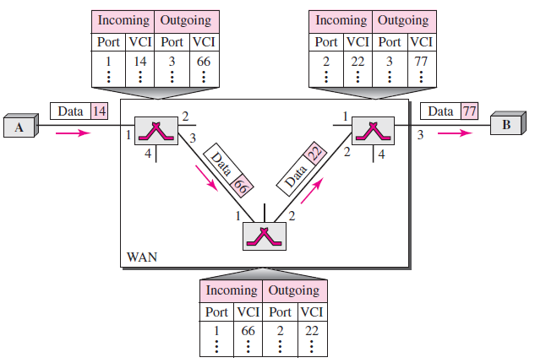
VIRTUAL-CIRCUIT NETWORKS: Data Transfer Phase
Figure shows how a frame from source A reaches destination B and how its VCI changes during the trip. Each switch changes the VCI and routes the frame.

Slide 35
VIRTUAL-CIRCUIT NETWORKS: Data Transfer Phase
The data transfer phase is active until the source sends all its frames to the destination.
The procedure at the switch is the same for each frame of a message.
The process creates a virtual circuit, not a real circuit, between the source and destination.

Slide 36
VIRTUAL-CIRCUIT NETWORKS: Setup Phase
In the setup phase, a switch creates an entry for a virtual circuit.
For example, suppose source A needs to create a virtual circuit to B. Two steps are required: the setup request and the acknowledgment.
A setup request frame is sent from the source to the destination.
Figure shows the process.
Source A sends a setup frame to switch 1.

Slide 37
VIRTUAL-CIRCUIT NETWORKS: Setup Phase
Switch 1 receives the setup request frame. It knows that a frame going from A to B goes out through port 3. The switch, in the setup phase, acts as a packet switch; it has a routing table which is different from the switching table. For the moment, assume that it knows the output port. The switch creates an entry in its table for this virtual circuit, but it is only able to fill three of the four columns. The switch assigns the incoming port (1) and chooses an available incoming VCI (14) and the outgoing port (3). It does not yet know the outgoing VCI, which will be found during the acknowledgment step. The switch then forwards the frame through port 3 to switch 2.

Slide 38
VIRTUAL-CIRCUIT NETWORKS: Setup Phase
Switch 2 receives the setup request frame. The same events happen here as at switch 1; three columns of the table are completed: in this case, incoming port (1), incoming VCI (66), and outgoing port (2).
Switch 3 receives the setup request frame. Again, three columns are completed: incoming port (2), incoming VCI (22), and outgoing port (3).
Destination B receives the setup frame, and if it is ready to receive frames from A, it assigns a VCI to the incoming frames that come from A, in this case 77. This VCI lets the destination know that the frames come from A, and not other sources.

Slide 39
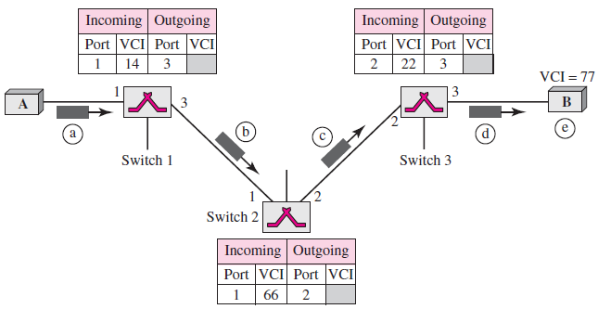

Slide 40
VIRTUAL-CIRCUIT NETWORKS: Setup Phase
Acknowledgment, A special frame, called the acknowledgment frame, completes the entries in the switching tables. Figure shows the process.
The destination sends an acknowledgment to switch 3. The acknowledgment carries the global source and destination addresses so the switch knows which entry in the table is to be completed. The frame also carries VCI 77, chosen by the destination as the incoming VCI for frames from A. Switch 3 uses this VCI to complete the outgoing VCI column for this entry. Note that 77 is the incoming VCI for destination B, but the outgoing VCI for switch 3.
Switch 3 sends an acknowledgment to switch 2 that contains its incoming VCI in the table, chosen in the previous step. Switch 2 uses this as the outgoing VCI in the table.
Switch 2 sends an acknowledgment to switch 1 that contains its incoming VCI in the table, chosen in the previous step. Switch 1 uses this as the outgoing VCI in the table.
Finally switch 1 sends an acknowledgment to source A that contains its incoming VCI in the table, chosen in the previous step.
The source uses this as the outgoing VCI for the data frames to be sent to destination B.

Slide 41
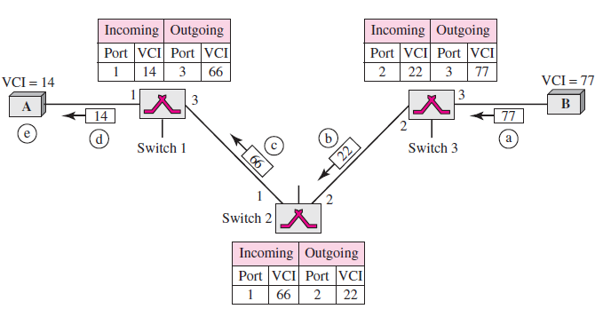

Slide 42
VIRTUAL-CIRCUIT NETWORKS: Teardown Phase
In this phase, source A, after sending all frames to B, sends a special frame called a teardown request.
Destination B responds with a teardown confirmation frame.
All switches delete the corresponding entry from their tables.

Slide 43
VIRTUAL-CIRCUIT NETWORKS: Efficiency
The resource reservation in a virtual-circuit network can be made during the setup or can be on demand during the data transfer phase.
In the first case, the delay for each packet is the same; in the second case, each packet may encounter different delays.
There is one big advantage in a virtual-circuit network even if resource allocation is on demand.
The source can check the availability of the resources, without actually reserving it.
Consider a family that wants to dine at a restaurant. Although the restaurant may not accept reservations (allocation of the tables is on demand), the family can call and find out the waiting time. This can save the family time and effort.

Slide 44
VIRTUAL-CIRCUIT NETWORKS: Delay
In a virtual-circuit network, there is a one-time delay for setup and a one-time delay for teardown.
If resources are allocated during the setup phase, there is no wait time for individual packets.
The packet is traveling through two switches (routers). There are three transmission times (3T ), three propagation times (3τ), data transfer depicted by the sloping lines, a setup delay (which includes transmission and propagation in two directions), and a teardown delay (which includes transmission and propagation in one direction).
We ignore the processing time in each switch. The total delay time is

Slide 45
IPv4 ADDRESSES
An IPv4 address is a 32-bit address that uniquely and universally defines the connection of a device (for example, a computer or a router) to the Internet.
IPv4 addresses are unique in the sense that each address defines one, and only one, connection to the Internet.
Two devices on the Internet can never have the same address at the same time.
By using some strategies, an address may be assigned to a device for a time period and then taken away and assigned to another device.

Slide 46
IPv4 ADDRESSES
If a device operating at the network layer has m connections to the Internet, it needs to have m addresses.
The IPv4 addresses are universal in the sense that the addressing system must be accepted by any host that wants to be connected to the Internet.

Slide 47
IPv4 ADDRESSES: Address Space
A protocol such as IPv4 that defines addresses has an address space.
An address space is the total number of addresses used by the protocol.
If a protocol uses N bits to define an address, the address space is 2^{N} because each bit can have two different values (0 or 1) and N bits can have 2^{N} values.

Slide 48
IPv4 ADDRESSES: Address Space
IPv4 uses 32-bit addresses, which means that the address space is 2³² or 4,294,967,296 (more than 4 billion).
This means that, theoretically, if there were no restrictions, more than 4 billion devices could be connected to the Internet.
But actual number is much less because of the restrictions imposed on the addresses.

Slide 49
IPv4 ADDRESSES: Notations
There are two prevalent notations to show an IPv4 address: binary notation and dotted decimal notation.
Binary Notation
In binary notation, the IPv4 address is displayed as 32 bits. Each octet is often referred to as a byte.
So it is common to hear an IPv4 address referred to as a 32-bit address or a 4-byte address.
The following is an example of an IPv4 address in binary notation:
01110101 10010101 00011101 00000010

Slide 50
IPv4 ADDRESSES: Notations
Dotted-Decimal Notation
To make the IPv4 address more compact and easier to read, Internet addresses are usually written in decimal form with a decimal point (dot) separating the bytes.
The following is the dotted-decimal notation of the above address:
117.149.29.2

Slide 51
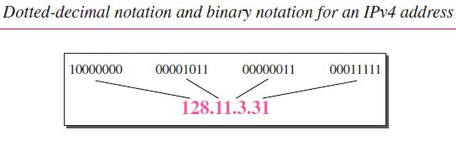
IPv4 ADDRESSES: Notations
Figure shows an IPv4 address in both binary and dotted-decimal notation. It is noted that because each byte (octet) is 8 bits, each number in dotted-decimal notation is a value ranging from 0 to 255.

Slide 52
Practice Exercise
Change the following IPv4 addresses from binary notation to dotted-decimal notation.
a. 10000001 00001011 00001011 11101111
b. 11000001 10000011 00011011 11111111

Slide 53
Solution
We replace each group of 8 bits with its equivalent decimal number (see Appendix B) and add
dots for separation.
a. 129.11.11.239
b. 193.131.27.255

Slide 54
Example 19.2
Change the following IPv4 addresses from dotted-decimal notation to binary notation.
a. 111.56.45.78
b. 221.34.7.82

Slide 55
Solution
We replace each decimal number with its binary equivalent
a. 01101111 00111000 00101101 01001110
b. 11011101 00100010 00000111 01010010

Slide 56
Find the error, if any, in the following IPv4 addresses.
a. 111.56.045.78
b. 221.34.7.8.20
c. 75.45.301.14
d. 11100010.23.14.67

Slide 57
Find the error, if any, in the following IPv4 addresses.
a. 111.56.045.78
b. 221.34.7.8.20
c. 75.45.301.14
d. 11100010.23.14.67

Slide 58
Solution
a. There must be no leading zero (045).
b. There can be no more than four numbers in an IPv4 address.
c. Each number needs to be less than or equal to 255 (301 is outside this range).
d. A mixture of binary notation and dotted-decimal notation is not allowed.

Slide 59
IPV4: Classful Addressing
This is scheme is becoming obsolete.
In classful addressing, the address space is divided into five classes: A, B, C, D, and E.
Each class occupies some part of the address space.
With the help of an address class can be found in both type of notations i.e. binary or dotted-decimal.

Slide 60
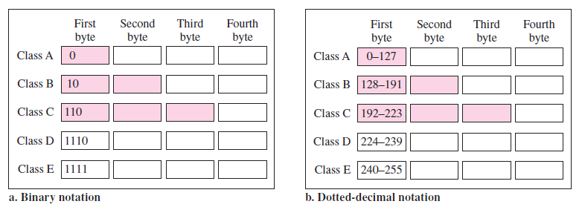

Slide 61
IPV4: Classful Addressing
Find the class of each address.
a. 00000001 00001011 00001011 11101111
b. 11000001 10000011 00011011 11111111
c. 14.23.120.8
d. 252.5.15.111

Slide 62
IPV4: Classful Addressing
Solution
a. The first bit is 0. This is a class A address.
b. The first 2 bits are 1; the third bit is 0. This is a class C address.
c. The first byte is 14 (between 0 and 127); the class is A.
d. The first byte is 252 (between 240 and 255); the class is E.

Slide 63
An IP address is a 32-bit unique address having an address space of 2³².

Slide 64
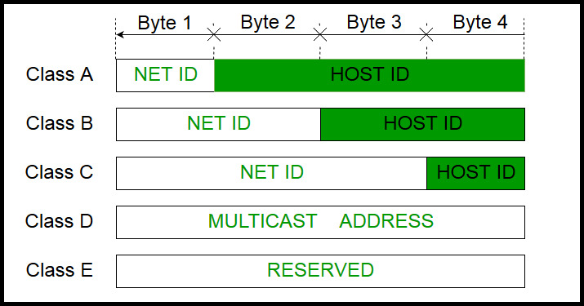
IPv4 address is divided into two parts: Network ID and Host ID
IP address has total of 4 bytes and is divided into 5 classes depending on the initial bit(s).
In class A, one byte define the netid and 3 bytes defines the hostid. In class B, two bytes define the netid and 2 bytes defines the hostid. In class C, three bytes define the netid and 1 byte defines the hostid.

Slide 65
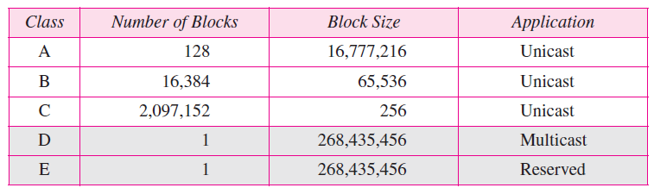
IPV4: Classes and Blocks
One problem with classful addressing is that each class is divided into a fixed number of blocks with each block having a fixed size as shown in Table:

Slide 66
Hence; for A - number of blocks = 2^7=128 as 1 bit( first bit) is reserved for class identification (0) and block size = 2^24 for B -number of blocks = 2^14=16384 as 2 bits are reserved for class identification (10) and block size = 2^16 = 65536 for C- number of blocks = 2^21= 2097152 as 3 bits are reserved for class identification (110) and block size = 2^8 =256
The system of netid and blockid is not applicable to class D and class E.
IP addresses are globally managed by Internet Assigned Numbers Authority(IANA) and regional Internet registries(RIR).

Slide 67
Note: While finding the total number of host IP addresses, 2 IP addresses are not counted and are therefore, decreased from the total count because the first IP address of any network is the network number and whereas the last IP address is reserved for broadcast IP.

Slide 68
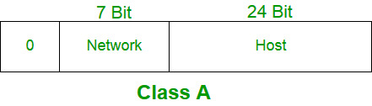
Class A addresses were designed for large organizations with a large number of attached hosts or routers.
Therefore, class A has a total of:
2^7-2= 126 network ID (Here 2 address is subtracted because 0.0.0.0 and 127.x.y.z are special address. )
2^24 – 2 = 16,777,214 host ID
The default subnet mask for class A is 255.0.0.0

Slide 69
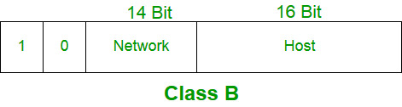
Class B:
Class B addresses were designed for midsize organizations with tens of thousands of attached hosts or routers.
The network ID is 16 bits long and host ID is also16 bits long.
The higher order bits of the first octet of IP addresses of class B are always set to 10. The remaining 14 bits are used to determine network ID. The 16 bits of host ID is used to determine the host in any network. The default sub-net mask for class B is 255.255.0.0. Class B has a total of:
2^14 = 16384 network address
2^16 – 2 = 65534 host address

Slide 70
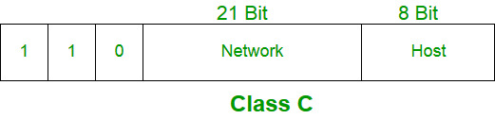
Class C:
Class C addresses were designed for small organizations with a small number of attached hosts or routers.
The network ID is 24 bits long and host ID is 8 bits long.
The higher order bits of the first octet of IP addresses of class C are always set to 110. The remaining 21 bits are used to determine network ID. The 8 bits of host ID is used to determine the host in any network. The default sub-net mask for class C is 255.255.255.0. Class C has a total of:
2^21 = 2097152 network address
2^8 – 2 = 254 host address

Slide 71
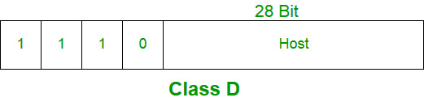
Class D:
IP address belonging to class D are reserved for multi-casting. The higher order bits of the first octet of IP addresses belonging to class D are always set to 1110. The remaining bits are for the address that interested hosts recognize.
Class D does not posses any sub-net mask.

Slide 72
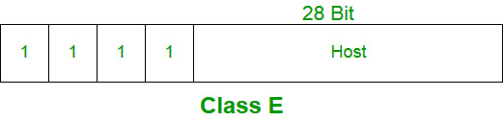
Class E:
IP addresses belonging to class E are reserved for experimental and research purposes. This class doesn’t have any sub-net mask. The higher order bits of first octet of class E are always set to 1111.

Slide 73
IPV4: Classful Addressing
Class D addresses were designed for multicasting, Each address in this class is used to define one group of hosts on the Internet. The Internet authorities wrongly predicted a need for 268,435,456 groups. This never happened and many addresses were wasted here too.
The class E addresses were reserved for future use; only a few were used, resulting in another waste of addresses

Slide 74
Example:
1. IP address: 84.42.58.11
Binary Notation: 01010100 00101010 00111010 00001011
It is a class A IP address.
The network address /netid is 84.0.0.0
The host addresses /hostid is 0.42.58.11
2. IP address: 144.62.12.9
It is a class B IP address.
The network address /netid is 144.62.0.0
The host addresses /hostid is 0.0.12.9

Slide 75
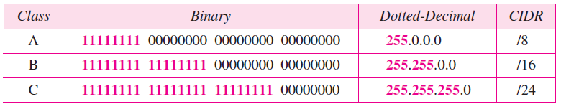
IPV4: Mask
Although the length of the netid and hostid (in bits) is predetermined in classful addressing, a mask can be also used (also called the default mask), a 32-bit number made of contiguous 1s followed by contiguous 0s.
The concept does not apply to classes D and E.

Slide 76
IPV4: Mask
The mask can help us to find the netid and the hostid.
For example, the mask for a class A address has eight 1s, which means the first 8 bits of any address in class A define the netid; the next 24 bits define the hostid.
The last column of Table shows the mask in the form /n where n can be 8, 16, or 24 in classful addressing.
This notation is also called slash notation or Classless Interdomain Routing (CIDR) notation.

Slide 77
Problems with Classful Addressing:
The problem with this classful addressing method is that millions of class A address are wasted, many of the class B address are wasted, whereas number of addresses available in class C is so small that it cannot cater the needs of organizations. Class D addresses are used for multicast routing and are therefore available as a single block only. Class E addresses are reserved.
Since there are these problems, Classful networking was replaced by Classless Inter-Domain Routing (CIDR) in 1993.

Slide 78
IPV4: Subnetting
During the era of classful addressing, subnetting was introduced.
If an organization was granted a large block in class A or B, it could divide the addresses into several contiguous groups and assign each group to smaller networks (called subnets) or, in rare cases, share part of the addresses with neighbors.
Subnetting increases the number of 1s in the mask, as we will see later when we discuss classless addressing.

Slide 79
IPV4: Supernetting
The time came when most of the class A and class B addresses were decreasing; however, there was still a huge demand for midsize blocks.
The size of a class C block with a maximum number of 256 addresses did not satisfy the needs of most organizations.
Even a midsize organization needed more addresses. One solution was supernetting.
In supernetting, an organization can combine several class C blocks to create a larger range of addresses.
An organization can apply for a set of class C blocks instead of just one. For example, an organization that needs 1000 addresses can be granted four contiguous class C blocks.
The organization can then use these addresses to create one supernetwork.
Supernetting decreases the number of 1s in the mask. For example, if an organization is given four class C addresses, the mask changes from /24 to /22.
The classless addressing eliminated the need for supernetting.

Slide 80
IPV4: Classless Addressing
To overcome address depletion and give more organizations access to the Internet, classless addressing was designed and implemented.
In this scheme, there are no classes, but the addresses are still granted in blocks.
Address Blocks
In classless addressing, when an entity, small or large, needs to be connected to the Internet, it is granted a block (range) of addresses.
The size of the block (the number of addresses) varies based on the nature and size of the entity.
For example, a household may be given only two addresses; a large organization may be given thousands of addresses.
An ISP, as the Internet service provider, may be given thousands or hundreds of thousands based on the number of customers it may serve.

Slide 81
IPV4: Classless Addressing
Restriction: To simplify the handling of addresses, the Internet authorities impose three restrictions on classless address blocks:
1. The addresses in a block must be contiguous, one after another.
2. The number of addresses in a block must be a power of 2 (1, 2, 4, 8, . . . ).
3. The first address must be evenly divisible by the number of addresses.

Slide 82
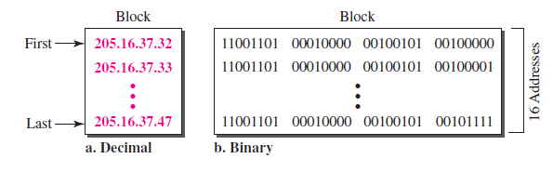
IPV4: Classless Addressing
The addresses are contiguous.
The number of addresses is a power of 2 (16 = 2⁴), and the first address is divisible by 16.
The first address, when converted to a decimal number, is 3,440,387,360, which when divided by 16 results in 215,024,210.

Slide 83
IPV4: Classless Addressing
Mask
A better way to define a block of addresses is to select any address in the block and the mask.
A mask is a 32-bit number in which the n leftmost bits are 1s and the 32 − n rightmost bits are 0s.
However, in classless addressing the mask for a block can take any value from 0 to 32.
It is very convenient to give just the value of n preceded by a slash (CIDR notation).
E.g. x.y.z.t /n in which x.y.z.t defines one of the addresses and the /n defines the mask.
Number of Addresses -The number of addresses in the block is the difference between the last and first address. It can easily be found using the formula 2^(32−n) . i.e. Total number of IP’s.

Slide 84
Example
The first address in the block can be found by setting the 32 − n rightmost bits in the binary notation of the address to 0s.
A block of addresses is granted to a small organization. We know that one of the addresses is 205.16.37.39/28. What is the first address in the block?
Solution
The binary representation of the given address is 11001101 00010000 00100101 00100111. If we set 32 − 28 rightmost bits to 0, we get 11001101 0001000 00100101 00100000 or 205.16.37.32.

Slide 85
Example
Find the last address for the block in above Example
Solution: The binary representation of the given address is 11001101 00010000 00100101 00100111. If we set 32 − 28 rightmost bits to 1, we get 11001101 00010000 00100101 00101111 or 205.16.37.47.

Slide 86
Number of Addresses-The number of addresses in the block is the difference between the last and first address. It can easily be found using the formula 2^{32−n}.
Find the number of addresses in above Example.
Solution
The value of n is 28, which means that number of addresses is 2⁽³²⁻²⁸⁾ or 16.

Slide 87



Another way to find the first address, the last address, and the number of addresses is to represent the mask as a 32-bit binary (or 8-digit hexadecimal) number. This is particularly useful when we are writing a program to find these pieces of information. In Example the /28 can be represented as 11111111 11111111 11111111 11110000 (twenty-eight 1s and four 0s). Find
a. The first address
b. The last address
c. The number of addresses

Slide 88
IPV4: Network Addresses
A very important concept in IP addressing is the network address.
When an organization is given a block of addresses, the organization is free to allocate the addresses to the devices that need to be connected to the Internet.
The first address in the class, however, is normally (not always) treated as a special address.
The first address is called the network address and defines the organization network.
It defines the organization itself to the rest of the world.
The first address is the one that is used by routers to direct the message sent to the organization from the outside.

Slide 89
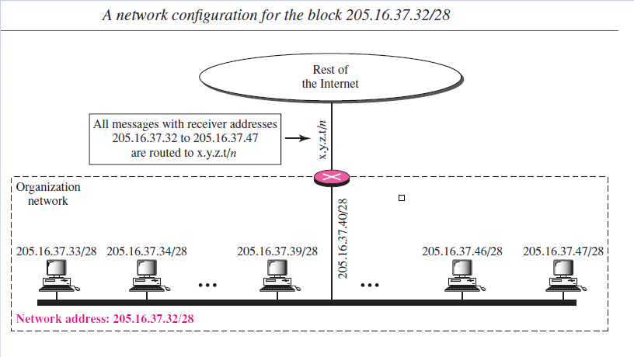

Slide 90
IPV4: Network Addresses
The organization network is connected to the Internet via a router.
The router has two addresses. One belongs to the granted block; the other belongs to the network that is at the other side of the router.
This is called the second address x.y.z.t/n because it is not known about the network it is connected to at the other side.
All messages destined for addresses in the organization block (205.16.37.32 to 205.16.37.47) are sent, directly or indirectly, to x.y.z.t/n.
It can be said directly or indirectly because we do not know the structure of the network to which the other side of the router is connected.

Slide 91
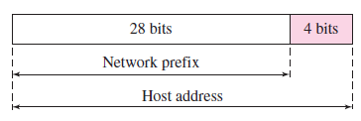
Two Level Hierarchy
An IP address can define only two levels of hierarchy when not subnetted.
The n leftmost bits of the address x.y.z.t/n define the network (organization network); the 32 − n rightmost bits define the particular host (computer or router) to the network.
The two common terms are prefix and suffix.
The part of the address that defines the network is called the prefix; the part that defines the host is called the suffix.

Slide 92
Three-Levels of Hierarchy: Subnetting
An organization that is granted a large block of addresses may want to create clusters of networks (called subnets) and divide the addresses between the different subnets.
All messages are sent to the router address that connects the organization to the rest of the Internet; the router routes the message to the appropriate subnets.
The organization, however, needs to create small subblocks of addresses, each assigned to specific subnets.
The organization has its own mask; each subnet must also have its own.
As an example, suppose an organization is given the block 17.12.14.0/26, which contains 64 addresses.
The organization has three offices and needs to divide the addresses into three subblocks of 32, 16, and 16 addresses.

Slide 93
Three-Levels of Hierarchy: Subnetting
New masks can be found by using the following arguments:
1. Suppose the mask for the first subnet is n1, then 2^{32−n1} must be 32, which means that n1 = 27.
2. Suppose the mask for the second subnet is n2, then 2^{32−n2} must be 16, which means that n2 = 28.
3. Suppose the mask for the third subnet is n3, then 2^{32−n3} must be 16, which means that n3 = 28.
This means that we have the masks 27, 28, 28 with the organization mask being 26.

Slide 94
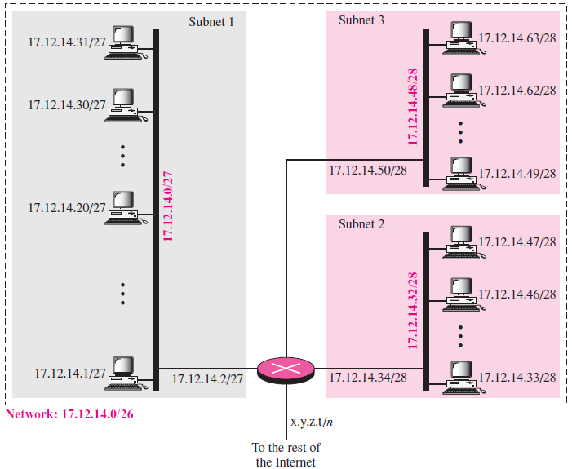

Slide 95



In subnet 1, the address 17.12.14.29/27 can give us the subnet address if we use the mask /27
b. In subnet 2, the address 17.12.14.45/28 can give us the subnet address if we use the mask /28
c. In subnet 3, the address 17.12.14.50/28 can give us the subnet address if we use the mask /28

Slide 96
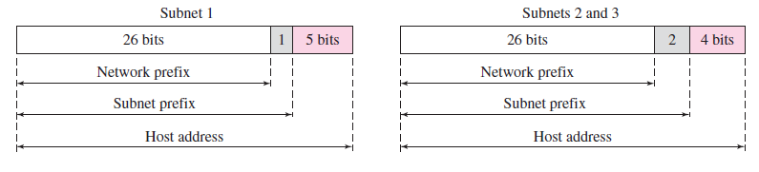
Three-Levels of Hierarchy: Subnetting

Slide 97
Question
An organization is granted a block starting with
190.100.0.0 /16. The ISP wants to distribute these addresses to three groups of customers as follows
a) the first group has 64 customers :each needs 256 addresses.
b) the second group has 128 customers :each needs 128 addresses.
c) the third group has 128 customers :each needs 64 addresses.
Design the sub blocks

Slide 98
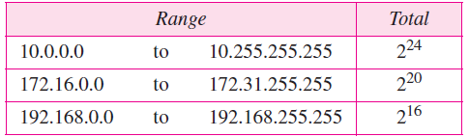
IPV4: Network Address Translation (NAT)
Network Address Translation (NAT) enables a user to have a large set of addresses internally and one address, or a small set of addresses, externally.
The traffic inside can use the large set; the traffic outside, the small set.
To separate the addresses used inside the home or business and the ones used for the Internet, the Internet authorities have reserved three sets of addresses as private addresses.

Slide 99
IPV4: Network Address Translation (NAT)
Any organization can use an address out of this set without permission from the Internet authorities.
Everyone knows that these reserved addresses are for private networks.
They are unique inside the organization, but they are not unique globally.
No router will forward a packet that has one of these addresses as the destination address.
The site must have only one single connection to the global Internet through a router that runs the NAT software.

Slide 100
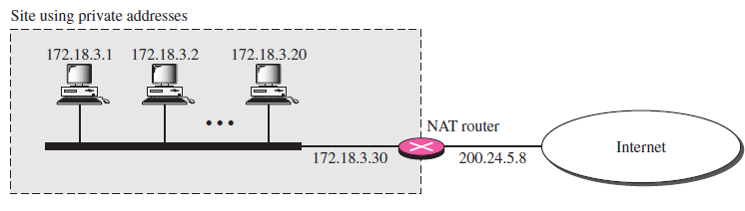
IPV4: Network Address Translation (NAT)
The private network uses private addresses. The router that
connects the network to the global address uses one private address and one global address. The private network is transparent to the rest of the Internet; the rest of the Internet sees only the NAT router with the address 200.24.5.8.

Slide 101
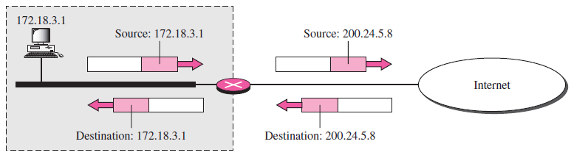
Network Address Translation (NAT): Address Translation
All the outgoing packets go through the NAT router, which replaces the source address in the packet with the global NAT address.
All incoming packets also pass through the NAT router, which replaces the destination address in the packet (the NAT router global address) with the appropriate private address.

Slide 102
Network Address Translation (NAT): Translation Table
The NAT router identify the private IP destination addresses which belongs to one specific host with the help of translation table.
In its simplest form, a translation table has only two columns: the private address and the external address (destination address of the packet).
When the router translates the source address of the outgoing packet, it also makes note of the destination address—where the packet is going.
When the response comes back from the destination, the router uses the source address of the packet (as the external address) to find the private address of the packet.

Slide 103
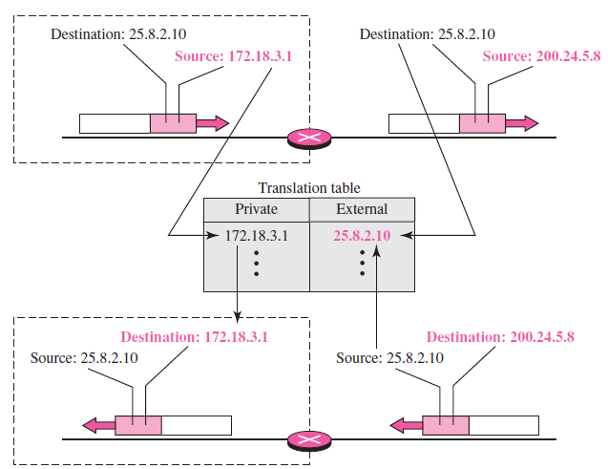

Slide 104
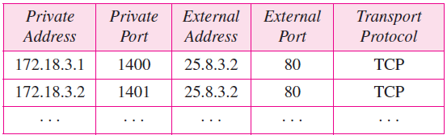
Network Address Translation (NAT): Translation Table
Because of only one global address, only one private network can access the same external hosts. This restriction can overcome with following methods:
One, more than one global addresses can be used. Still there is restriction.
Second, Add more information in Translation table.

Slide 105
Network Address Translation (NAT): Translation Table
NAT is used mostly by ISPs which assign one single address to a customer.
The customer, however, may be a member of a private network that has many private addresses.
In this case, communication with the Internet is always initiated from the customer site, using a client program such as HTTP, TELNET, or FTP to access the corresponding server program.
For example, when e-mail that originates from a non-customer site is received by the ISP e-mail server, the e-mail is stored in the mailbox of the customer until retrieved.
A private network cannot run a server program for clients outside of its network if it is using NAT technology.

Slide 106
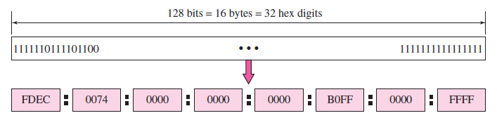
IPv6 ADDRESSES
Structure: An IPv6 address consists of 16 bytes (octets); it is 128 bits long.
Hexadecimal Colon Notation: To make addresses more readable, IPv6 specifies hexadecimal colon notation. In this notation, 128 bits is divided into eight sections, each 2 bytes in length. Two bytes in hexadecimal notation requires four hexadecimal digits. Therefore, the address consists of 32 hexadecimal digits, with every four digits separated by a colon

Slide 107
IPv6 ADDRESSES
Although the IP address, even in hexadecimal format, is very long, many of the digits are zeros.
In this case, we can abbreviate the address. The leading zeros of a section (four digits between two colons) can be omitted.
Only the leading zeros can be dropped, not the trailing zeros
https://www.techrepublic.com/blog/10-things/10-things-you-should-know-about-ipv6-addressing/

Slide 108
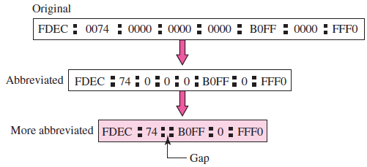

Slide 109
IPv6 ADDRESSES
Using this form of abbreviation, 0074 can be written as 74, 000F as F, and 0000 as 0.
Further abbreviations are possible if there are consecutive sections consisting of zeros only.
We can remove the zeros altogether and replace them with a double semicolon.
Note that this type of abbreviation is allowed only once per address.
If there are two runs of zero sections, only one of them can be abbreviated.
Reexpansion of the abbreviated address is very simple: Align the unabbreviated portions and insert zeros to get the original expanded address.

Slide 110
Expand the address 0:15::1:12:1213 to its original.
Solution We first need to align the left side of the double colon to the left of the original pattern and the right side of the double colon to the right of the original pattern to find how many 0s we need to replace the double colon.
This means that the original address is

Slide 111
IPV6 Features
Larger Address Space
Simplified Header
End-to-end Connectivity (No Need of NAT)
Auto-configuration (No need of DHCP)
Faster Forwarding/Routing
IPSec
No Broadcast
Anycast Support
Mobility (Same IP address in different geographical areas)

Slide 112
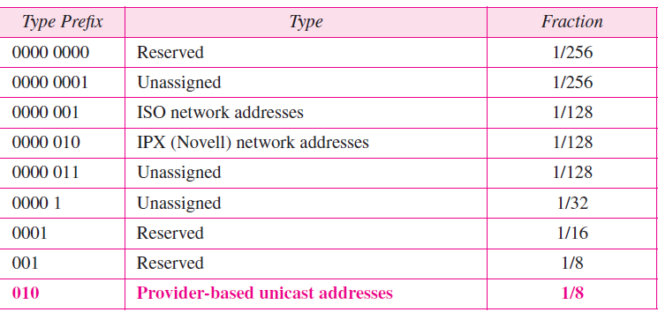
Address Space
IPv6 has a much larger address space; 2¹²⁸ addresses are available.
The designers of IPv6 divided the address into several categories.
A few leftmost bits, called the type prefix, in each address define its category. The type prefix is variable in length, but it is designed such that no code is identical to the first part of any other code.
In this way, there is no ambiguity; when an address is given, the type prefix can easily be determined. Table shows the prefix for each type of address. The third column shows the fraction of each type of address relative to the whole address space.

Slide 113
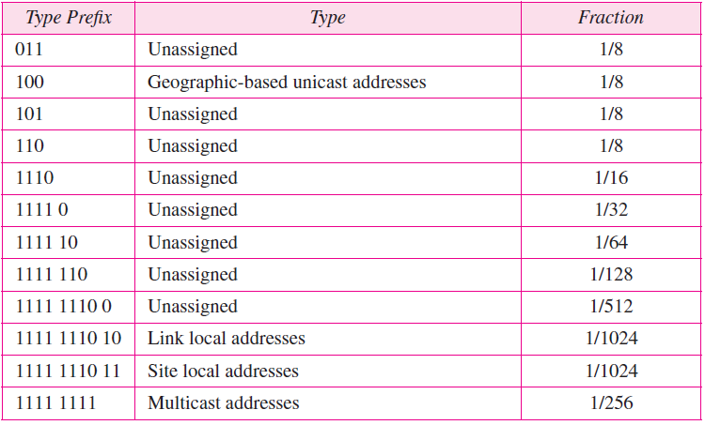

Slide 114
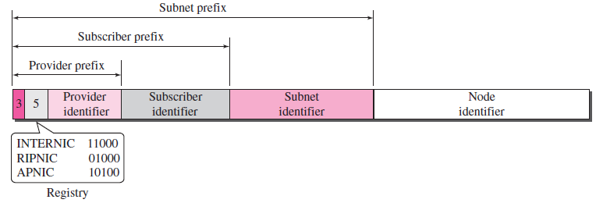
Unicast Addresses
A unicast address defines a single computer. The packet sent to a unicast address must be delivered to that specific computer.
IPv6 defines two types of unicast addresses: geographically based and provider-based.
Only the second type here; the first type is left for future definition.
The provider-based address is generally used by a normal host as a unicast address.

Slide 115
Unicast Addresses
Fields for the provider-based address are as follows:
Type identifier. This 3-bit field defines the address as a provider-based address.
Registry identifier. This 5-bit field indicates the agency that has registered the address.
Currently three registry centers have been defined. INTERNIC (code 11000) is the center for North America; RIPNIC (code 01000) is the center for European registration; and APNIC (code 10100) is for Asian and Pacific countries.

Slide 116
Unicast Addresses
Provider identifier. This variable-length field identifies the provider for Internet access (such as an ISP). A 16-bit length is recommended for this field.
Subscriber identifier. When an organization subscribes to the Internet through a provider, it is assigned a subscriber identification. A 24-bit length is recommended for this field.
Subnet identifier. Each subscriber can have many different subnetworks, and each subnetwork can have an identifier. The subnet identifier defines a specific subnetwork under the territory of the subscriber. A 32-bit length is recommended for this field.
Node identifier. The last field defines the identity of the node connected to a subnet. A length of 48 bits is recommended for this field to make it compatible with the 48-bit link (physical) address used by Ethernet. In the future, this link address will probably be the same as the node physical address.

Slide 117
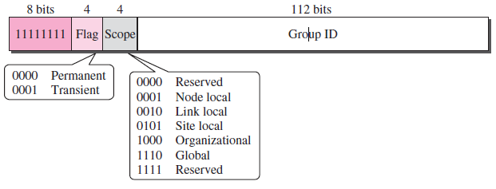
Multicast Addresses
Multicast addresses are used to define a group of hosts instead of just one.
A packet sent to a multicast address must be delivered to each member of the group. Figure shows the format of a multicast address.

Slide 118
Multicast Addresses
The second field is a flag that defines the group address as either permanent or transient.
A permanent group address is defined by the Internet authorities and can be accessed at all times.
A transient group address, on the other hand, is used only temporarily. Systems engaged in a teleconference, for example, can use a transient group address.
The third field defines the scope of the group address. Many different scopes have been defined,

Slide 119
Anycast Address
IPv6 also defines anycast addresses. An anycast address, like a multicast address, also defines a group of nodes.
However, a packet destined for an anycast address is delivered to only one of the members of the anycast group, the nearest one (the one with the shortest route).
Although the definition of an anycast address is still debatable, one possible use is to assign an anycast address to all routers of an ISP that covers a large logical area in the Internet.
The routers outside the ISP deliver a packet destined for the ISP to the nearest ISP router.
No block is assigned for anycast addresses.

Slide 120
Address Mapping
An internet is made of a combination of physical networks connected by internetworking devices such as routers.
A packet starting from a source host may pass through several different physical networks before finally reaching the destination host.
The hosts and routers are recognized at the network level by their logical (IP) addresses.
However, packets pass through physical networks to reach these hosts and routers.
At the physical level, the hosts and routers are recognized by their physical addresses.
A physical address is a local address which is unique locally but is not necessarily unique universally.
It is usually (but not always) implemented in hardware.
An example of a physical address is the 48-bit MAC address in the Ethernet protocol, which is imprinted on the NIC installed in the host or router.

Slide 121
Address Mapping
The physical address and the logical address are two different identifiers.
Both addresses are required because a physical network such as Ethernet can have two different protocols at the network layer such as IP and IPX (Novell) at the same time.
Likewise, a packet at a network layer such as IP may pass through different physical networks such as Ethernet and LocalTalk (Apple).
This means that delivery of a packet to a host or a router requires two levels of addressing: logical and physical.
There is need to be able to map a logical address to its corresponding physical address and vice versa.
These can be done by using either static or dynamic mapping.

Slide 122
Static mapping
Static mapping involves in the creation of a table that associates a logical address with a physical address.
This table is stored in each machine on the network.
Each machine that knows, for example, the IP address of another machine but not its physical address can look it up in the table.
This has some limitations because physical addresses may change in the following ways:
1. A machine could change its NIC, resulting in a new physical address.
2. In some LANs, such as LocalTalk, the physical address changes every time the computer is turned on.
3. A mobile computer can move from one physical network to another, resulting in a change in its physical address.
To implement these changes, a static mapping table must be updated periodically.
This overhead could affect network performance.

Slide 123
Dynamic mapping: Use a protocol to find another address Address Resolution Protocol (ARP) Mapping Logical to Physical Address
The sender knows the IP address of the target.
IP asks ARP to create an ARP request message, filling in the sender physical address, the sender IP address, and the target IP address. The target physical address field is filled with 0s.
The message is passed to the data link layer where it is encapsulated in a frame by using the physical address of the sender as the source address and the physical broadcast address as the destination address.
Every host or router receives the frame. Because the frame contains a broadcast destination address, all stations remove the message and pass it to ARP. All machines except the one targeted drop the packet. The target machine recognizes its IP address.
The target machine replies with an ARP reply message that contains its physical address. The message is unicast.

Slide 124
ARP
The sender receives the reply message. It now knows the physical address of the target machine.
The IP datagram, which carries data for the target machine, is now encapsulated in a frame and is unicast to the destination.
A system that receives an ARP reply stores the mapping in the cache memory and keeps it for 20 to 30 minutes unless the space in the cache is exhausted.
Before sending an ARP request, the system first checks its cache to see if it can find the mapping.
An ARP packet is encapsulated directly into a data link frame.
An ARP packet is encapsulated in an Ethernet frame.
Note that the type field indicates that the data carried by the frame are an ARP packet.

Slide 125
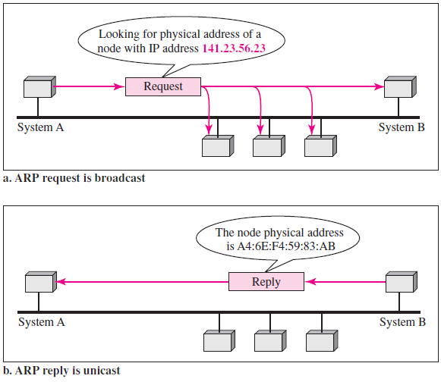

Slide 126
ARP – ADDRESS RESOLUTION Protocol
We need protocols to create a mapping between physical and logical addresses.
IP packets use logical (host-to-host) addresses. These packets, however, need to be encapsulated in a frame, which needs physical addresses (node-to-node). We will see that a protocol called ARP, the Address Resolution Protocol, is designed for this purpose.
We sometimes need reverse mapping—mapping a physical address to a logical address.
For example, when booting a diskless network or leasing an IP address to a host. Three protocols are designed for this purpose: RARP, BOOTP, and DHCP.

Slide 127
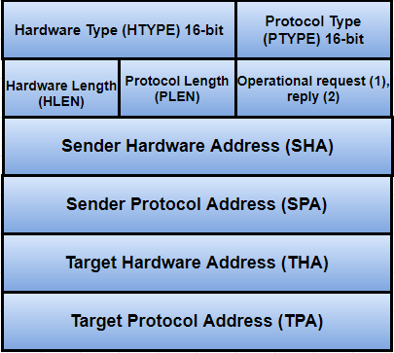
ARP Frame Format and types

Slide 128
Hardware type Each data link layer protocol is assigned a number used in this field. For Ethernet it is 1.
Protocol type Each protocol is assigned a number used in this field. For example, IPv4 is 0x0800.
Hardware length Length in bytes of a hardware address. Ethernet addresses are 6 bytes long.
Protocol length Length in bytes of a logical address. IPv4 addresses are 4 bytes long.
Operation Specifies the operation the sender is performing: 1 for request, and 2 for reply.

Slide 129
There are actually four types of ARP messages that may be sent by the ARP protocol. These are identified by four values in the “operation” field of an ARP message. The types of message are:
1.ARP request 2.ARP reply 3.RARP request 4.RARP reply

Slide 130
Sender hardware address Hardware address of the sender.
Sender protocol address Protocol address of the sender.
Target hardware address Hardware address of the intended receiver. This field is zero on request.
Target protocol address Protocol address of the intended receiver.

Slide 131
Proxy ARP
Proxy ARP is used to create subnetting effect means one proxy ARP that acts on behalf of a set of hosts.
Whenever a router running a proxy ARP receives an ARP request looking for the IP address of one of these hosts, the router sends an ARP reply announcing its own hardware (physical) address.
After the router receives the actual IP packet, it sends the packet to the appropriate host or router.

Slide 132
Mapping Physical to Logical Address: RARP, BOOTP, and DHCP
There are occasions in which a host knows its physical address, but needs to know its logical address. This may happen in two cases:
1. A diskless station is just booted. The station can find its physical address by checking its interface, but it does not know its IP address.
2. An organization does not have enough IP addresses to assign to each station; it needs to assign IP addresses on demand. The station can send its physical address and ask for a short time lease.

Slide 133
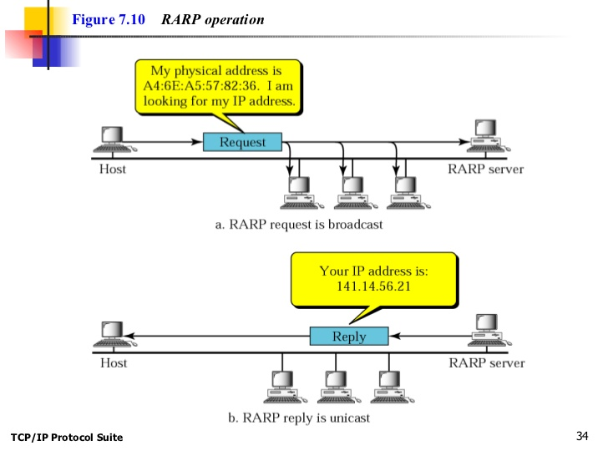
Mapping Physical to Logical Address: RARP, BOOTP, and DHCP

Slide 134
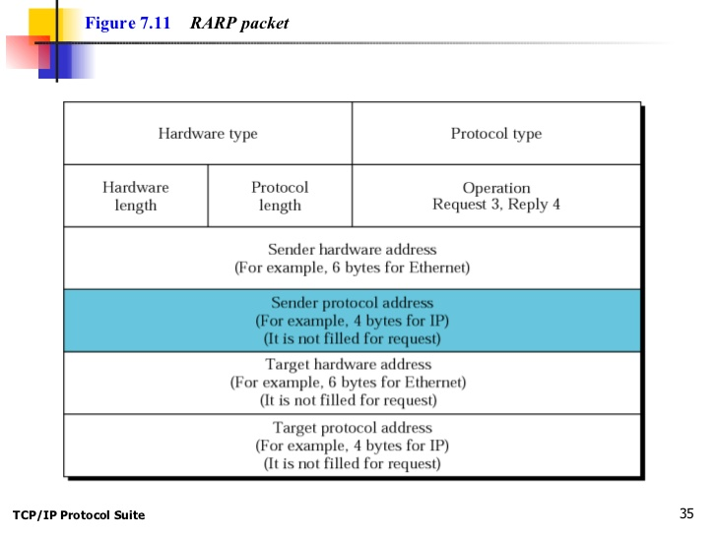

Slide 135
RARP (Reverse Address Resolution Protocol)
RARP (Reverse Address Resolution Protocol) is a protocol by which a physical machine in a local area network can request to learn its IP address from a gateway server's Address Resolution Protocol (ARP) table or cache.
A network administrator creates a table in a local area network's gateway router that maps the physical machine (or Media Access Control - MAC address) addresses to corresponding Internet Protocol addresses.
When a new machine is set up, its RARP client program requests from the RARP server on the router to be sent its IP address. Assuming that an entry has been set up in the router table, the RARP server will return the IP address to the machine which can store it for future use.
Request for Comments RFC903

Slide 136
How is RARP different from ARP ?
RARP | ARP
RARP stands for Reverse Address Resolution Protocol | ARP stands for Address Resolution Protocol
The MAC address is known, and the IP address is requested | The IP address is known, and the MAC address is being requested
It uses the value 3 for requests and 4 for responses | It uses the value 1 for requests and 2 for responses

Slide 137
Bootstrap Protocol (BOOTP)
The Bootstrap Protocol (BOOTP) is a client/server protocol designed to map physical address to logical address mapping. BOOTP is an application layer protocol.
The administrator may put the client and the server on the same network or on different networks.
BOOTP messages are encapsulated in a User Datagram Protocol (UDP packet), and the UDP packet itself is encapsulated in an IP packet.
The client simply uses all 0s as the source IP address and all 1s as the destination IP address.

Slide 138
Bootstrap Protocol (BOOTP)
The BOOTP request is broadcast because the client does not know the IP address of the server.
A broadcast IP datagram cannot pass through any router. To solve the problem, there is a need for an intermediary.
One of the hosts (or a router that can be configured to operate at the application layer) can be used as a relay.
The host in this case is called a relay agent.
The relay agent knows the unicast address of a BOOTP server.
When it receives this type of packet, it encapsulates the message in a unicast datagram and sends the request to the BOOTP server.
The packet, carrying a unicast destination address, is routed by any router and reaches the BOOTP server.
The BOOTP server knows the message comes from a relay agent because one of the fields in the request message defines the IP address of the relay agent.
The relay agent, after receiving the reply, sends it to the BOOTP client.

Slide 139
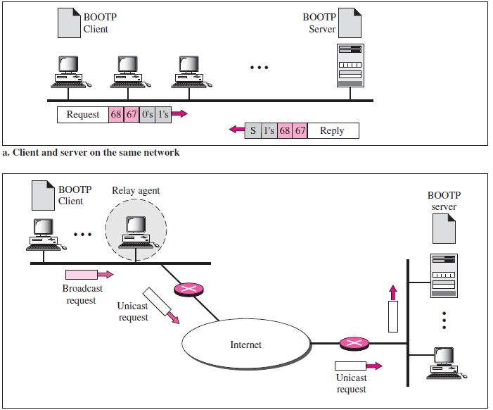

Slide 140
Dynamic Host Configuration Protocol (DHCP)
BOOTP is not a dynamic configuration protocol. When a client requests its IP address, the BOOTP server consults a table that matches the physical address of the client with its IP address.
This implies that the binding between the physical address and the IP address of the client already exists.
The binding is predetermined.
However, what if a host moves from one physical network to another? What if a host wants a temporary IP address? BOOTP cannot handle these situations because the binding between the physical and IP addresses is static and fixed in a table until changed by the administrator.
BOOTP is a static configuration protocol.

Slide 141
Dynamic Host Configuration Protocol (DHCP)
Static Address Allocation In this capacity DHCP acts as BOOTP does. It is backward compatible with BOOTP, which means a host running the BOOTP client can request a static address from a DHCP server. A DHCP server has a database that statically binds physical addresses to IP addresses.
Dynamic Address Allocation DHCP has a second database with a pool of available IP addresses. This second database makes DHCP dynamic. When a DHCP client requests a temporary IP address, the DHCP server goes to the pool of available (unused) IP addresses and assigns an IP address for a negotiable period of time.

Slide 142
Dynamic Host Configuration Protocol (DHCP)
When a DHCP client sends a request to a DHCP server, the server first checks its static database.
If an entry with the requested physical address exists in the static database, the permanent IP address of the client is returned.
On the other hand, if the entry does not exist in the static database, the server selects an IP address from the available pool, assigns the address to the client, and adds the entry to the dynamic database.
The dynamic aspect of DHCP is needed when a host moves from network to network or is connected and disconnected from a network.
DHCP provides temporary IP addresses for a limited time.
The addresses assigned from the pool are temporary addresses. The DHCP server issues a lease for a specific time. When the lease expires, the client must either stop using the IP address or renew the lease.
The server has the option to agree or disagree with the renewal.
If the server disagrees, the client stops using the address.

Slide 143
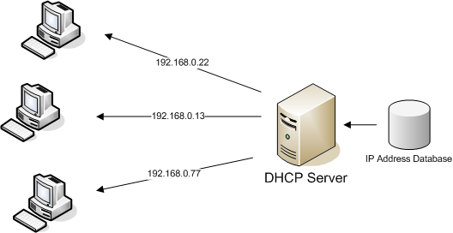

Slide 144
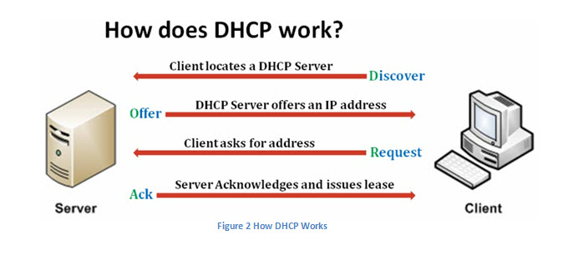

Slide 145
Difference
RARP = I broadcast MAC address, you give me IP address. end of conversation.
BOOTP = I broadcast MAC address, you give me IP address, default gateway, subnet mask, maybe a cookie, and other options. IP address is fixed in a table.
DHCP = like BOOTP - but IP address is dynamic.

Slide 146
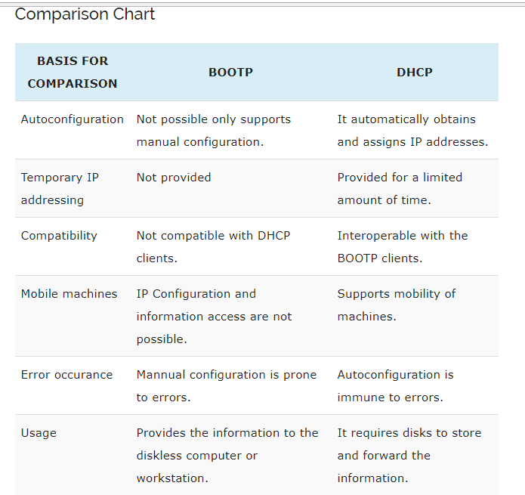

Slide 147
Packet Delivery
The network layer supervises the handling of the packets by the underlying physical Networks
It can be broadly classified as
Direct Delivery
Direct delivery occurs when the source and destination of the packet are located on the same physical network or when the delivery is between the last router and the destination host.
Indirect Delivery
In an indirect delivery, the packet goes from router to router until it reaches the one connected to the same physical network as its final destination.

Slide 148
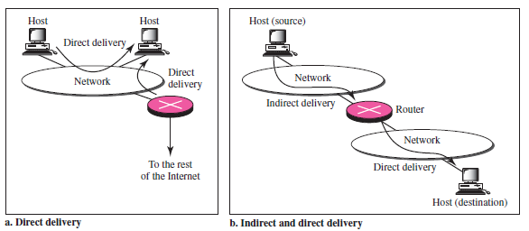

Slide 149
Packet Forwarding Techniques
The Forwarding means to place the packet in its route to its destination
Forwarding requires a host or a router to have a routing table
When a host has a packet to send or when a router has received a packet to be forwarded, it looks at this table to find the route to the final destination
However, this simple solution is impossible today in an internetwork such as the Internet because the number of entries needed in the routing table would make table lookups inefficient

Slide 150
Packet Forwarding Methods
Next-Hop Method
Route Method
Network-Specific Method
Host-Specific Method

Slide 151
Route Method and Next-Hop Method
One technique to reduce the contents of a routing table is called the next-hop method
In this technique, the routing table holds only the address of the next hop instead of information about the complete route (route method).
The entries of a routing table must be consistent with one another

Slide 152
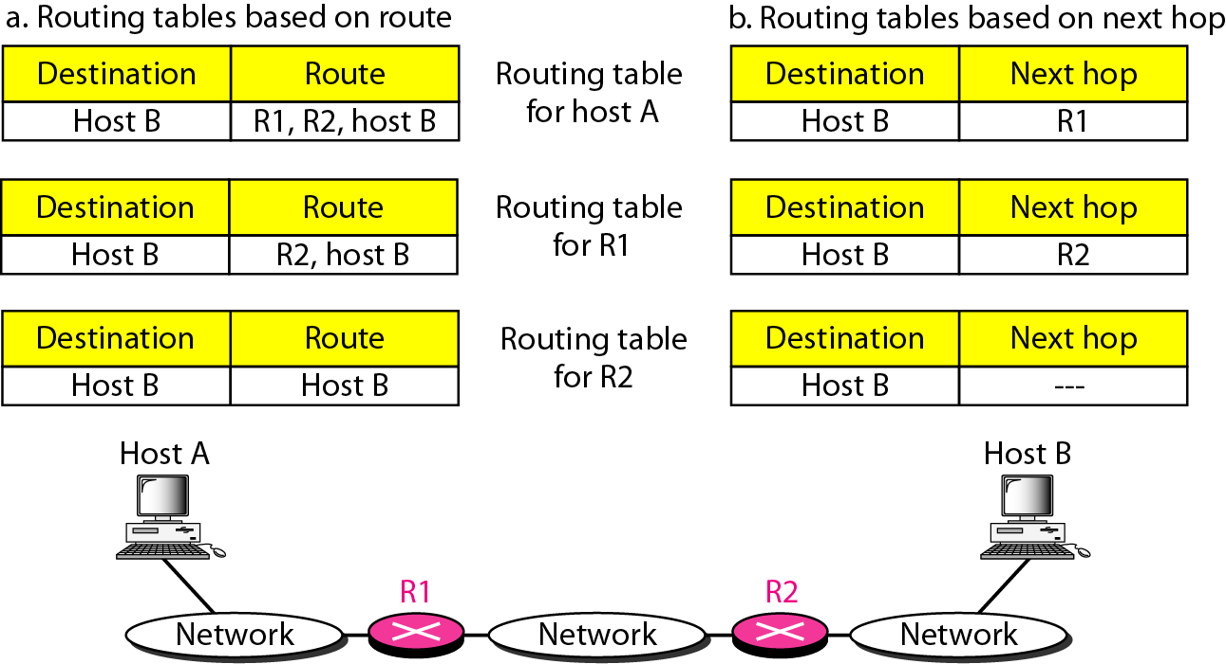
Route Method and Next-Hop Method

Slide 153
Network-Specific and Host-Specific Method
Another technique to reduce the routing table and simplify the searching process is called the network-specific method
Instead of having an entry for every destination host connected to the same physical network (host-specific method)
We have only one entry that defines the address of the destination network itself
In other words, we treat all hosts connected to the same network as one single entity

Slide 154
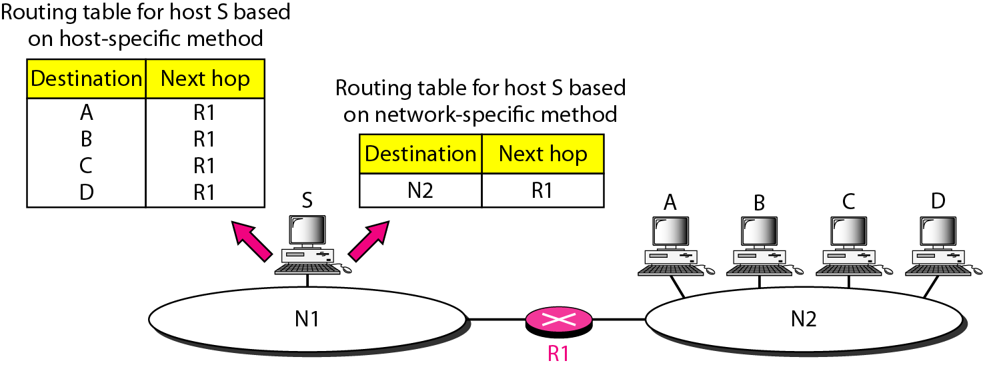
Host-Specific and Network-Specific Method

Slide 155
Default Route
A default route of a computer that is participating in computer networking is the packet forwarding rule (route) taking effect when no other route can be determined for a given Internet Protocol (IP) destination address
All packets for destinations not established in the routing table are sent via the default route

Slide 156
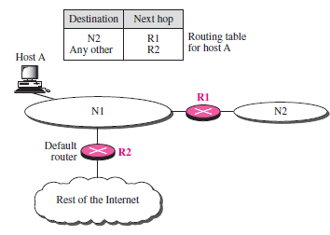

Slide 157
Routing and Routing Protocols
Routing is a process in which the layer 3 devices find the optimal path to deliver a packet from one network to another. Communication between one sender and one receiver is called unicast routing.
Routing Properties
correctness
simplicity
robustness
updating possibility
should cope with changes in the topology and traffic
stability
optimality
min packet delay
max network throughput
Routing Protocols are the set of defined rules used by the routers to communicate between source & destination.

Slide 158
A UNICAST ROUTING PROTOCOLS
An autonomous system is a group of networks and routers under the authority of a single administration
Routing inside an autonomous system is referred to as intradomain routing
Routing between autonomous systems is referred to as interdomain routing
Each autonomous system can choose one or more intradomain routing protocols to handle routing inside the autonomous system
However, only one interdomain routing protocol handles routing between autonomous systems.
A static route is a route that manually inserted into the routing table.
In dynamic routing, devices build and maintain their routing tables automatically by using routing protocols to exchange information about the surrounding network topology.

Slide 159

Routing Protocols Classification
Routing Information Protocol (RIP)
Open Shortest Path First (OSPF)
Border Gateway Protocol (BGP)

Slide 160
Distance Vector Routing

Slide 161
Distance Vector Routing Protocol
In distance vector routing, the least-cost route between any two nodes is the route with minimum distance
In this protocol, as the name implies, each node maintains a vector (table) of minimum distances to every node
The table at each node also guides the packets to the desired node by showing the next stop in the route (next-hop routing)
We can think of nodes as the cities in an area and the lines as the roads connecting them
A table can show a tourist the minimum distance between cities

Slide 162
Distance Vector Routing Protocol
Distance vector protocols advertise routing information by sending messages, called routing updates, out the interfaces on a router
Distance vector routing has three steps:
Initialization
Sharing
Updation

Slide 163
Distance Vector Routing Protocol
Initialization: Each node knows how to reach any other node and the cost
At the beginning, each node can know only the distance between itself and its immediate neighbors, those directly connected to it
So for the moment, we assume that each node can send a message to the immediate neighbors and find the distance between itself and these neighbors
The distance for any entry that is not a neighbor is marked as infinite (unreachable).

Slide 164
Distance Vector Routing Protocol
Sharing: The whole idea of distance vector routing is the sharing of information between neighbors
In distance vector routing, each node shares its routing table with its
immediate neighbors periodically and when there is a change.

Slide 165
Distance Vector Routing Protocol
Updation: When a node receives a two-column table from a neighbor, It update the table according to minimum value. Updating takes three steps:
1. The receiving node needs to add the cost between itself and the sending node to each value in the second column. For example: If node C has distance to a destination is x, and the distance between A and C is y, then the distance between A and that destination, via C, is x + y.
2. The receiving node needs to add the name of the sending node to each row as the third column if the receiving node uses information from any row. The sending node is the next node in the route.

Slide 166
Distance Vector Routing Protocol
3. The receiving node needs to compare each row of its old table with the corresponding row of the modified version of the received table.
a. If the next-node entry is different, the receiving node chooses the row with the smaller cost. If there is a tie, the old one is kept.
b. If the next-node entry is the same, the receiving node chooses the new row. For example, suppose node C has previously advertised a route to node X with distance 2. Suppose that now there is no path between C and X; node C now advertises this route with a distance of infinity. Node A must not ignore this value even though its old entry is smaller. The old route does not exist any more. The new route has a distance of infinity.

Slide 167

Distance Vector Routing Protocol

Slide 168

Distance Vector Routing Protocol

Slide 169

Distance Vector Routing Protocol

Slide 170
Example of Distance Vector Routing Protocol
Routing Information Protocol
Based on Distance Vector Routing
Distance metric = hop count. The path with the least hop count will be chosen as the best path.
each router shares its knowledge about the entire AS
it is unimportant how much it knows; it sends whatever it has
sharing only with neighbours
updates exchanged among neighbours every 30 sec
RIP response message
Send the distance to networks within autonomous system.

Slide 171
Link State Routing Protocol

Slide 172
Link State Routing Protocol
Link state routing is a technique in which each router shares the knowledge of its neighborhood with every other router in the internetwork.
The three keys to understand the Link State Routing algorithm:
Knowledge about the neighborhood: Instead of sending its routing table, a router sends the information about its neighborhood only. A router broadcast its identities and cost of the directly attached links to other routers.
Flooding: Each router sends the information to every other router on the internetwork. This process is known as Flooding. Every router that receives the packet sends the copies to all its neighbors. Finally, each and every router receives a copy of the same information.
Information sharing: A router sends the information to every other router only when the change occurs in the information.

Slide 173

Link State Routing Protocol

Slide 174

Link State Routing Protocol

Slide 175
Link State Routing Protocol
In link state routing, four sets of actions are required to ensure that each node has the routing table showing the least-cost node to every other node.
Creation of the states of the links by each node, called the link state packet (LSP).
Dissemination of LSPs to every other router, called flooding, in an efficient and reliable way.
Formation of a shortest path tree for each node.
Calculation of a routing table based on the shortest path Dijkstra’s algorithm (Shortest Path Routing).

Slide 176

Link State Routing Protocol

Slide 177
Link State Routing Protocol

Slide 178
Inter Domain Routing

Slide 179
Path Vector Routing Protocol
In path vector routing, we assume that there is one node in each autonomous system that acts on behalf of the entire autonomous system.
Let us call it the speaker node. The speaker node in an AS creates a routing table and advertises it to speaker nodes in the neighbouring ASs.
The idea is the same as for distance vector routing except that only speaker nodes in each AS can communicate with each other.
A speaker node advertises the path, not the metric of the nodes, in its autonomous system or other autonomous systems.
Path vector routing has three steps:
Initialization
Sharing
Updation

Slide 180

Path Vector Routing Protocol: Initialization

Slide 181

Path Vector Routing Protocol: Updating

Slide 182
PREVENTION OF LOOP
The creation of loop can be avoided in path vector routing .A router receives a message it checks to see if its autonomous system is in the path list to the destination if it is looping is involved and the message is ignored.
POLICY ROUTING
When a router receives a messages it can check the path, if one of the autonomous system listed in the path against its policy, it can ignore its path and destination it does not update its routing table with this path or it does not send the messages to its neighbours.
OPTIMUM PATH
A path to a destination that is the best for the organization that runs the autonomous system

Slide 183
Internet Protocol Version 4-
IPv4 short for Internet Protocol Version 4 is the fourth version of the Internet Protocol (IP).
IP is responsible to deliver data packets from the source host to the destination host.
This delivery is solely based on the IP Addresses in the packet headers.
IPv4 is the first major version of IP.
IPv4 is a connectionless protocol for use on packet-switched networks.

Slide 184


Slide 185
1. Version-
Version is a 4 bit field that indicates the IP version used.
The most popularly used IP versions are version-4 (IPv4) and version-6 (IPv6).
Only IPv4 uses the above header.
So, this field always contains the decimal value 4.
Header Length-
Header length is a 4 bit field that contains the length of the IP header.
It helps in knowing from where the actual data begins.
The length of IP header always lies in the range- [20 bytes to 60 bytes]
Concept of Scaling Factor-
Header length is a 4 bit field.
So, the range of decimal values that can be represented is [0, 15].
But the range of header length is [20, 60].
So, to represent the header length, we use a scaling factor of 4.

Slide 186
Type Of Service-
Type of service is a 8 bit field that is used for Quality of Service (QoS).
Total Length-
Total length is a 16-bit field that contains the total length of the datagram (in bytes).
Total length = Header length + Payload length
Minimum total length of datagram = 20 bytes (20 bytes header + 0 bytes data)
Maximum total length of datagram = Maximum value of 16-bit word = 65535 bytes

Slide 187
Identification-
Identification is a 16-bit field.
It is used for the identification of the fragments of an original IP datagram.
When an IP datagram is fragmented,
Each fragmented datagram is assigned the same identification number.
This number is useful during the reassembly of fragmented datagrams.
It helps to identify to which IP datagram; the fragmented datagram belongs to.
6. DF Bit-
DF bit stands for Do Not Fragment bit. Its value may be 0 or 1.
When DF bit is set to 0,
It grants the permission to the intermediate devices to fragment the datagram if required.
When DF bit is set to 1,
It indicates the intermediate devices not to fragment the IP datagram at any cost.
If network requires the datagram to be fragmented to travel further but settings does not allow its fragmentation, then it is discarded.
An error message is sent to the sender saying that the datagram has been discarded due to its settings.

Slide 188
MF Bit-
MF bit stands for More Fragments bit.
Its value may be 0 or 1.
When MF bit is set to 0,
It indicates to the receiver that the current datagram is either the last fragment in the set or that it is the only fragment.
When MF bit is set to 1,
It indicates to the receiver that the current datagram is a fragment of some larger datagram.
More fragments are following.
MF bit is set to 1 on all the fragments except the last one.

Slide 189
Fragment Offset-
Fragment Offset is a 13-bit field.
It indicates the position of a fragmented datagram in the original unfragmented IP datagram.
The first fragmented datagram has a fragment offset of zero.
Fragment offset for a given fragmented datagram
= Number of data bytes ahead of it in the original unfragmented datagram
Time To Live-
Time to live (TTL) is an 8-bit field.
It indicates the maximum number of hops a datagram can take to reach the destination.
The main purpose of TTL is to prevent the IP datagrams from looping around forever in a routing loop.
The value of TTL is decremented by 1 when-
Datagram takes a hop to any intermediate device having network layer.
Datagram takes a hop to the destination.
If the value of TTL becomes zero before reaching the destination, then datagram is discarded.

Slide 190
Protocol-
Protocol is a 8 bit field.
It tells the network layer at the destination host to which protocol the IP datagram belongs to.
In other words, it tells the next level protocol to the network layer at the destination side.
Protocol number of ICMP is 1, IGMP is 2, TCP is 6 and UDP is 17.
Source IP Address-
Source IP Address is a 32 bit field.
It contains the logical address of the sender of the datagram.
13. Destination IP Address-
Destination IP Address is a 32 bit field.
It contains the logical address of the receiver of the datagram.

Slide 191
Header Checksum-
Header checksum is a 16-bit field.
It contains the checksum value of the entire header.
The checksum value is used for error checking of the header.
At each hop,
The header checksum is compared with the value contained in this field.
If header checksum is found to be mismatched, then the datagram is discarded.
Router updates the checksum field whenever it modifies the datagram header.
The fields that may be modified are-
TTL
Options
Datagram Length
Header Length
Fragment Offset

Slide 192
Options-
Options is a field whose size vary from 0 bytes to 40 bytes.
This field is used for several purposes such as-
Source routing
Padding
Source Routing-
A source routing option is used to specify the route that the datagram must take to reach the destination.
This option is generally used to check whether a certain path is working fine or not.
Source routing may be loose or strict.
3. Padding-
Addition of dummy data to fill up unused space in the transmission unit and make it conform to the standard size is called as padding.

Slide 193

IPV6 Header Format
.
Version – version number of Internet Protocol = 6.
Traffic class – Priority or regular traffic.
Flow label – 20-bit field.
Payload length – Total length of data.
Next header – Identifies the type of header that immediately follows the IPv6 header. Hop limit – 8-bit unsigned integer. Decremented by one by each node that forwards the packet. The packet is discarded if the hop limit is decremented to zero.

Slide 194
Source address – 128 bits. The address of the initial sender of the packet.
Destination address – 128 bits. The address of the intended recipient of the packet. The intended recipient is not necessarily the recipient if an optional routing header is present.
The following IPv6 extension headers are currently defined:
Routing – Extended routing, such as IPv4 loose source route
Fragmentation – Fragmentation and reassembly
Authentication – Integrity and authentication, and security
Encapsulating Security Payload – Confidentiality
Hop-by-Hop options – Special options that require hop-by-hop processing
Destination options – Optional information to be examined by the destination node

Slide 195
.
The following lists the common next header values and their meanings
Value | Protocol header, or option
0 | Hop-by-Hop Options header
6 | TCP
17 | UDP
41 | Encapsulated IPv6 header
43 | Routing header
44 | Fragment header
50 | Encapsulating Security Payload header
51 | Authentication header
58 | ICMPv6
59 | No next header
60 | Destination Options header

